Slide 1


0 to Web Application in 60 minutes
Chris Nicholls
@chris_nicholls
Salesforce
Creative Consultant:
Trevor Bernard
@trevorbernard

Slide 2




Architecture of Web/Mobile Applications
Web
Web Service
Database
Mobile

Slide 3
Architecture of Web/Mobile Applications
Web
Web Service
Database
Mobile
Notes:
Next slide descibe reality

Slide 4

Architecture of Web/Mobile Applications
Databases
Web
Third Party Integrations
…
Web Service
Mobile
List Goes On
Notes:
Next slide is magic

Slide 5

Architecture of Web/Mobile Applications
Web
Mobile
Notes:
Next slide is cloud

Slide 6

Architecture of Web/Mobile Applications
Web
Mobile
Notes:
Next slide is cloud

Slide 7
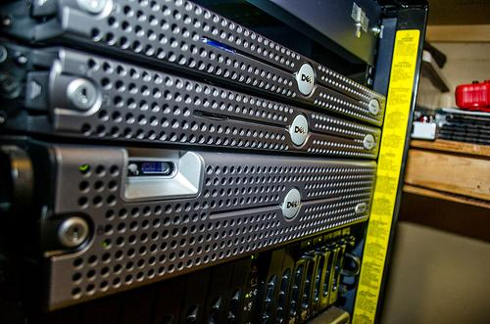
GET /person HTTP/1.1
Host: localhost
HTTP request with session cookie and various headers
Content-Encoding:gzip
Content-Type:application/json
Date:Tue, 26 Nov 2013 03:58:51 GMT
Transfer-Encoding:chunked
Vary:Accept-Encoding, User-Agent
{
"name":"Derek",
"email":"derek@hatchard.net",
"city":"New Maryland"
}

Slide 8
Web Services in the Real World aka APIs
https://dev.twitter.com
https://developers.facebook.com
http://developer.nytimes.com
http://developer.salesforce.com
https://code.exacttarget.com
https://developers.google.com
http://thecatapi.com
http://www.programmableweb.com/apis/directory

Slide 9
Get your Twitter feed via API: https://api.twitter.com/1.1/statuses/home_timeline.json

Slide 10


Slide 11
Resources
https://github.com/chrisnicholls/todomvc
https://github.com/chrisnicholls/todo-api
http://python.org
http://flask.pocoo.org/
http://todomvc.com/
https://www.linkedin.com/in/cnicholls
https://www.linkedin.com/in/trevorbernard

